Slide 1

Feasibility study
Pharmaceutical Company

Slide 2
1-project concept
-The project is for carrying out the detailed feasibility analysis for setting up a website for a pharmaceutical company To provide the company’s services from missing medicines and medical and surgical supplies to hospitals

Slide 3
2- project justification
Rising prices of medicines are putting them beyond the reach of many people, even in rich countries. In less-developed countries, millions of individuals do not have access to essential drugs. Drug development is failing to address the major health needs of these countries. The prices of patented medicines usually far exceed the marginal costs of their production; the industry maintains that high prices and patent protection are necessary to compensate for high development costs of innovative products. There is controversy over these claims. Concerns about the harmful effects of the international system of intellectual property rights have led the World Trade Organization to relax the demands placed on least developed countries, and to advocate differential pricing of essential drugs. How these actions will help countries that lack domestic production capacity is unclear. Better access to essential drugs may be achieved through voluntary licensing arrangements between international pharmaceutical companies and manufacturers in developing countries

Slide 4
* These problems are represented in the fact that there are many types of medicines that do not exist in the market due to the difficulty of importing these types and the lack of alternatives for them at a reduced price, and among the services provided by the company
-Providing alternatives to medicines that are not available in the market
-Easy and multiple payment methods
-Ease of dealing with hospitals and pharmacies with the
company- Save time, effort and money

Slide 5
3- marketing
SWOT ANALYSIS OF THE PROJECT:
-In this project management many members in our group are from an information technology (IT) background which is very helpful to our project
- The cost of all products such as hardware and software are given, which is useful for cost estimation
-We can attract more customers through online marketing.
The company provides some medicines that do not exist, as the company provides alternatives to these items, such as:
- يونيت كسات
"ماتر وكوند"، و"ايماتوسويكس“
"ديب وكورتين"
"تجترا"
ستير ونات
فأرما بريد
هالوبيردول ريتشارد

Slide 6
4-Technical
- Implementation stage:
- ISP internet service provider
-Network
-Hardware
= servers
= router
= cabling
= printers
= work station
-Software
= windows XP OS
=web server
= database designers
= php programmers
= graphic designers
- Testing team

Slide 7
- Structure of web application
- Before Login
= login
= register
= forget password
= user login
= contact us
= about us
- After user ( admin) login
= edit website details
= add drugs or medical products
= delete items
= see user –user orders – add user –delete users
= logout

Slide 8
After user( customer) login
- profile
= edit profile
= change password and his information
-Buy product
- Payment ways
= cards
= cash
- logout

Slide 9
- Tools and technique
- Php
- Xampp
- My sql
- Html
- Bootstrap
-github
-java script
-css
-logo
-images
- fonts
-icons
-background

Slide 10
5- cash flow projection
Total | Year 4 | Year 3 | Year 2 | Year 1 | Year 0
666,000$ | 225,000$ | 186,000$ | 145,000$ | 110,000$ |  | Total Benefits
310,000$ | 15,000$ | 20,000$ | 35,000$ | 40,000$ | 200,000$ | Total costs
356,000$ | 210,000$ | 166,000$ | 110,000$ | 70,000$ | [200,000$] | Net Benefits
 | 356,000$ | 146,000 | [20,000$] | [130,000$] | [200,000$] | Cumulative net cash flow

Slide 11
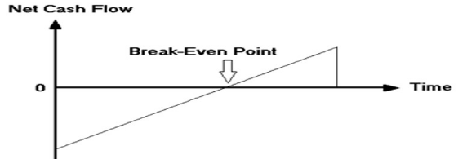
-return on investment ( ROI)
ROI = ( Total benefits − Total costs) / Total costs
ROI= ( 666,000 − 310,000) / 200,000
ROI =1,78
-Break –Even point ( BEP)
BEP = year negative +( year net cash − year comm) / year coom
BEP = 2 + ( 166,000 − 146,000 ) / 166,000 = 2.12

Slide 12
-discounted cash flow projection
calculated using a 10 % required rate of return
Total | Year 4 | Year 3 | Year2 | Year 1 | Year 0
 | 225,000$ | 186,000$ | 145,000$ | 110,000$ |  | Total Benefits
513,257.5$ | 153,678$ | 139,744.5$ | 119,835$ | 100,000$ |  | Pv of total benefits
 | 15,000$ | 20,000$ | 35,000$ | 40,000$ | 200,000$ | Total costs
90,560.9$ | 10,245.2$ | 15,026.3$ | 28,925.62$ | 36,363.68$ | 200,000$ | Pv of total costa

Slide 13
NET present value( NPV)
NPV = PV of total benefits − PV of total costs
NPV =513,257 − 90,560.9 = 422,69.1

Slide 14
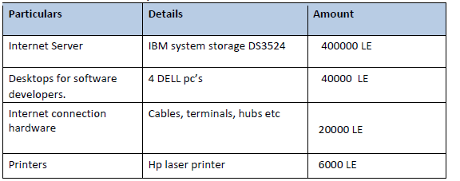
- Hardware Requirements

Slide 15
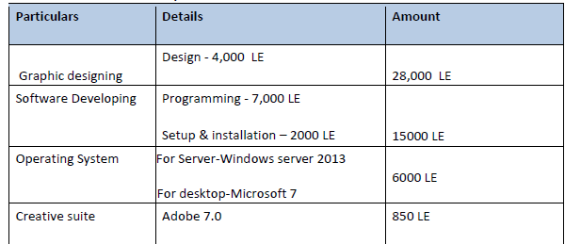
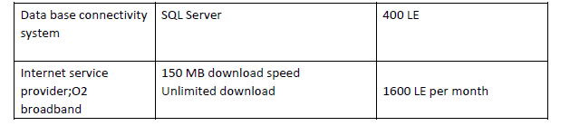
Software Requirements

